Slide 1

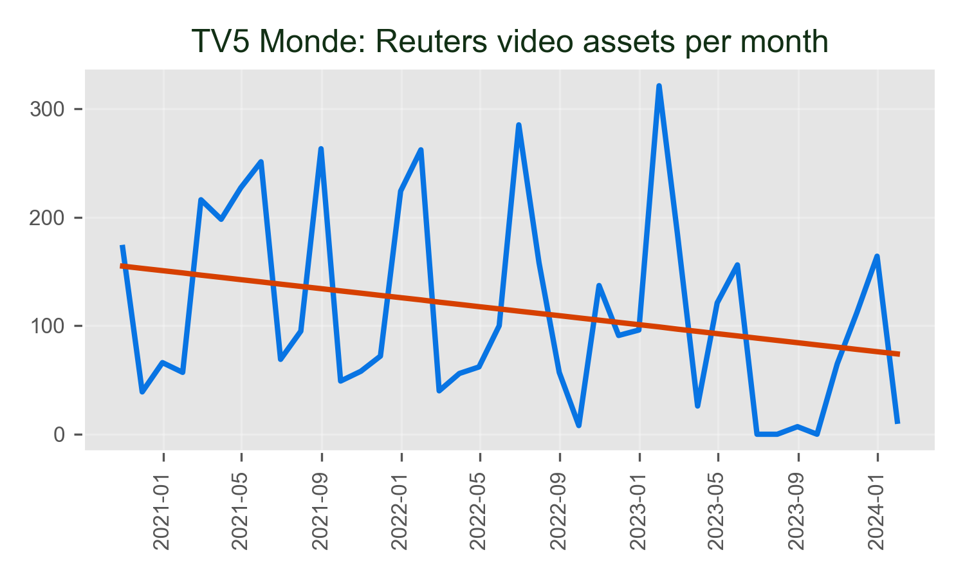
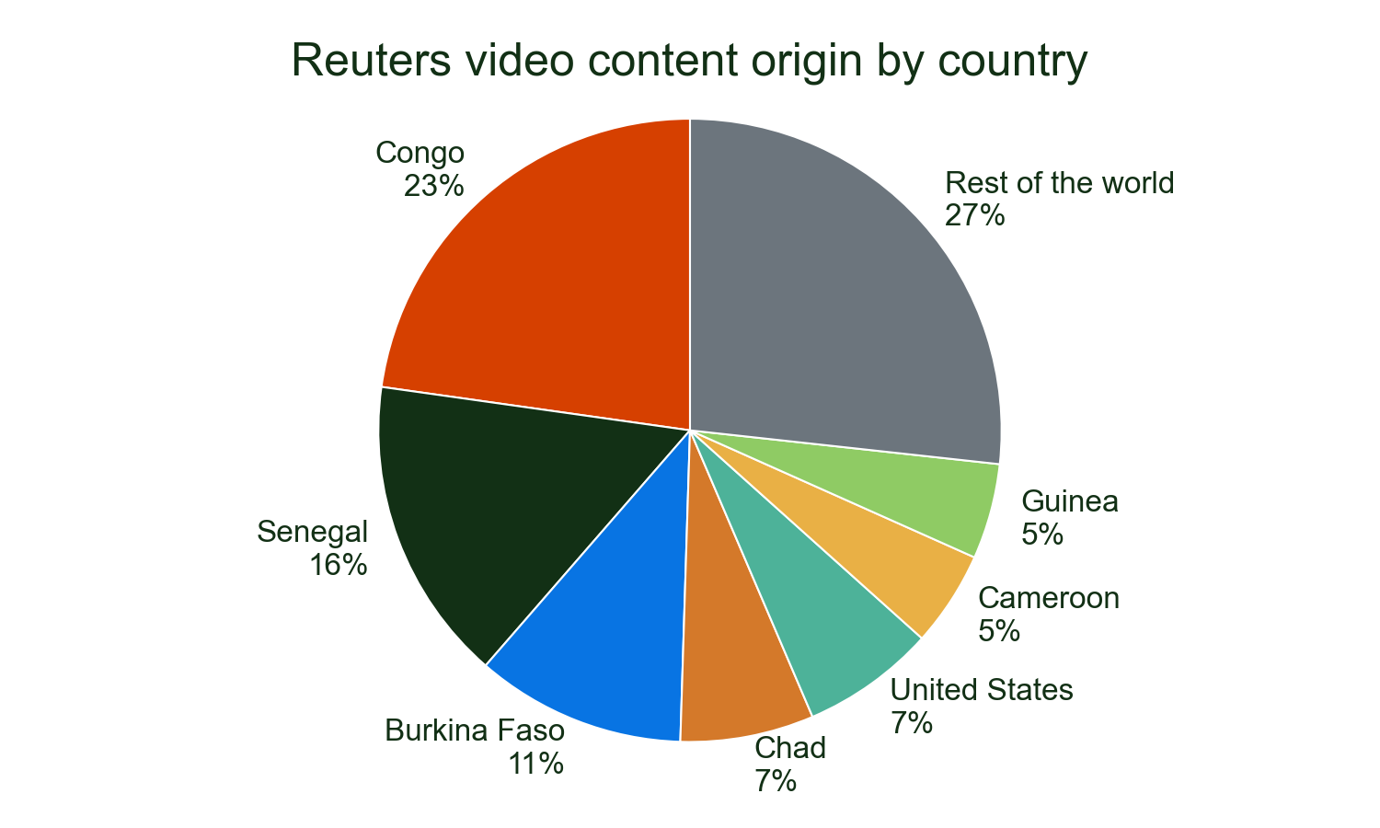
TV5 Monde's use of Reuters video progressed its gentle downwards trend in 2024, which has seen baseline usage gentle in the last 4 years.
It remains very reliant on Reuters video for coverage from the US and used nearly 4,577 video assets from 1 countries.
Major stories
• SENEGAL: 14.3%
• CONGO: 13.1%
• BURKINA: 11.8%
Of all detections of Reuters video on TV5 Monde in 2024.

